Slide 1
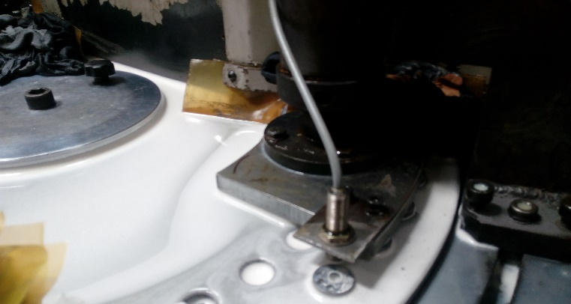
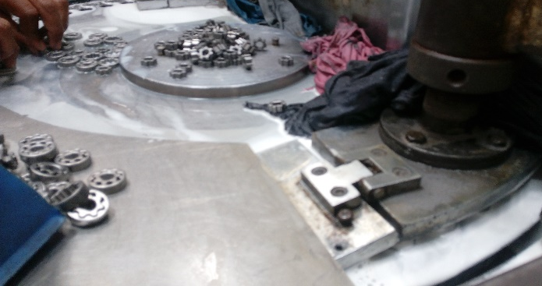
AHPL/QMS/FR/09/E
TPM CIRCLE NO :-
ACTIVITY
KK
QM
PM
JH
SHE
OT
DM
E&T
KAIZEN IDEA SHEET
TPM CIRCLE NAME:
LOSS NO. / STEP
DEPT :-Maint.
RESULT AREA
P
Q
A
C
D
S
M
CELL:-Machine Shop
CELL NAME:-
MACHINE / STAGE :-
OPERATION :-
KAIZEN THEME : TO increase MTBF on Turning at grinding cell
Z axis not properly reference due to burr collecting on sensor .
IDEA :-Use coolant level indicator for OFF coolant motor when coolant level low
Problem present status :-
COUNTERMEASURE:-Implement Limit switch on turning of grinding .
BENCHMARK
12500
TARGET
0
KAIZEN START
10.1.2017
TDC
Proximity Switch
Limit Switch
KAIZEN FINISH
15.1.2017
TEAM MEMBERS : Vasant Lagad ,
Sudhir Musale
BENEFITS :- 1) Cost Save.
2)MTBF Increases .
3)Improve JH
Before
After
KAIZEN SUSTENANCE
WHY - WHY ANALYSIS :-
Why provide limit switch .
Z not reference collecting
Due to burr on reference sensor .
Sensor not properly counting on guard
Due to axis movable
Burr on sensor & it continuously work
RESULT :-
WHAT TO DO:-
HOW TO DO:-
FREQUENCY :-
ROOT CAUSE :- Burr on sensor & it continuously work
REGISTRATION NO. & DATE : 15 .3.2017
SCOPE & PLAN FOR HORIZONTAL DEPLOYMENT
REGISTERED BY :- Vasant Lagad
SR.
NO.
CELL
TARGET
RESPONSIBILITY
STATUS
MANAGER’S SIGN :- SNC
1
Cleaning
25.2.17
Rahul
C

